Slide 1

saranza
team
activity 6
sambas
salinas
libranza

Slide 2
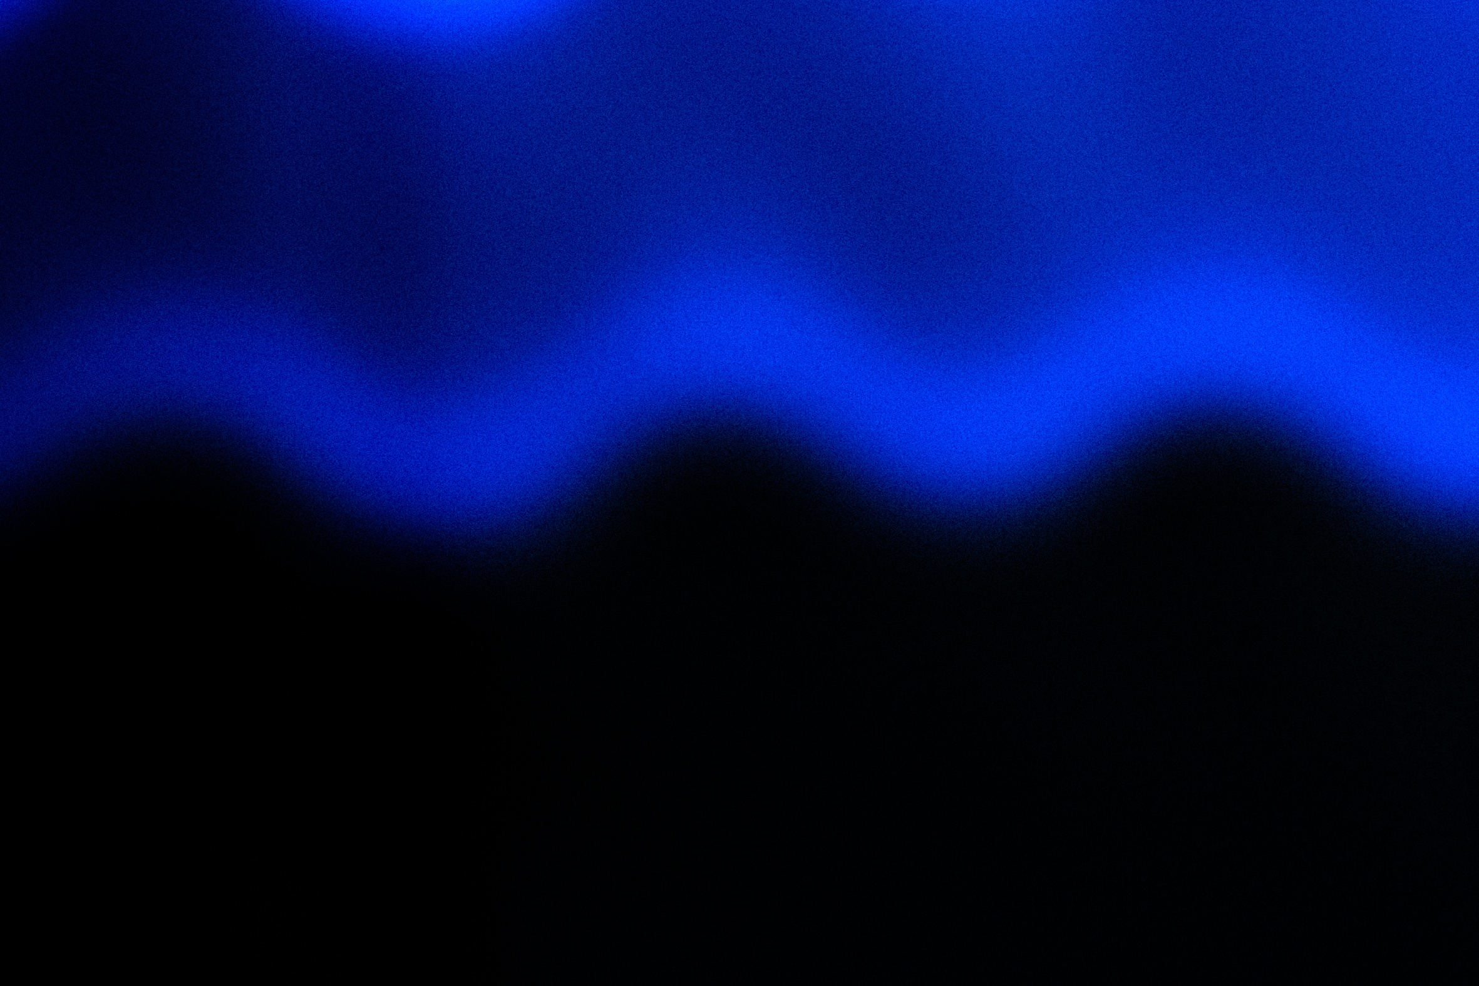

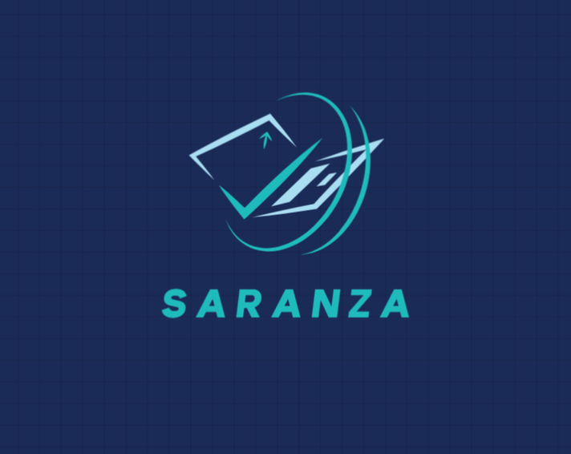
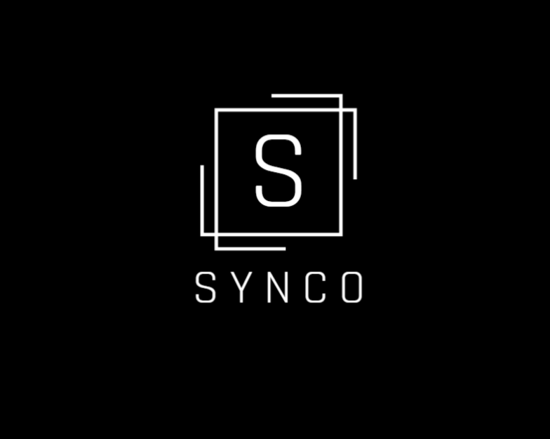
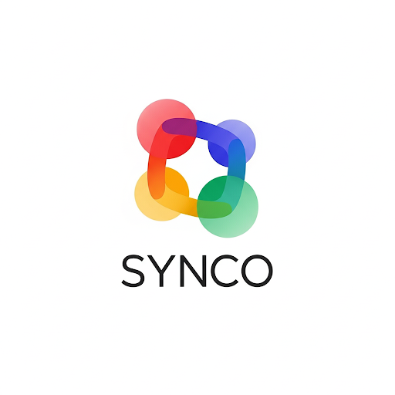
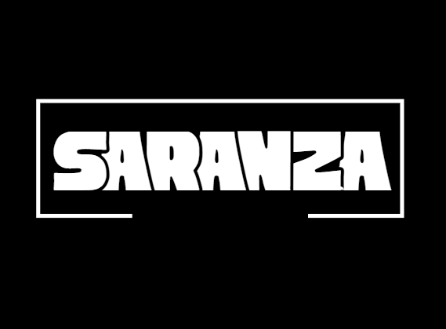
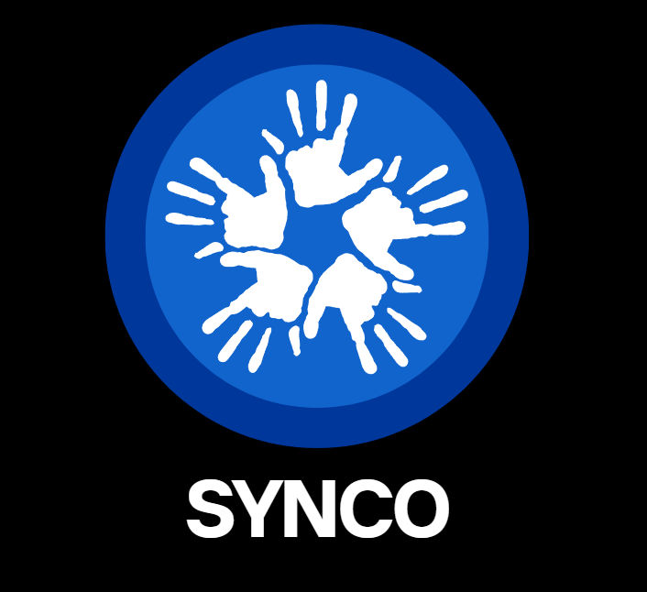
team saranza logo
SYNCO logo

Slide 3
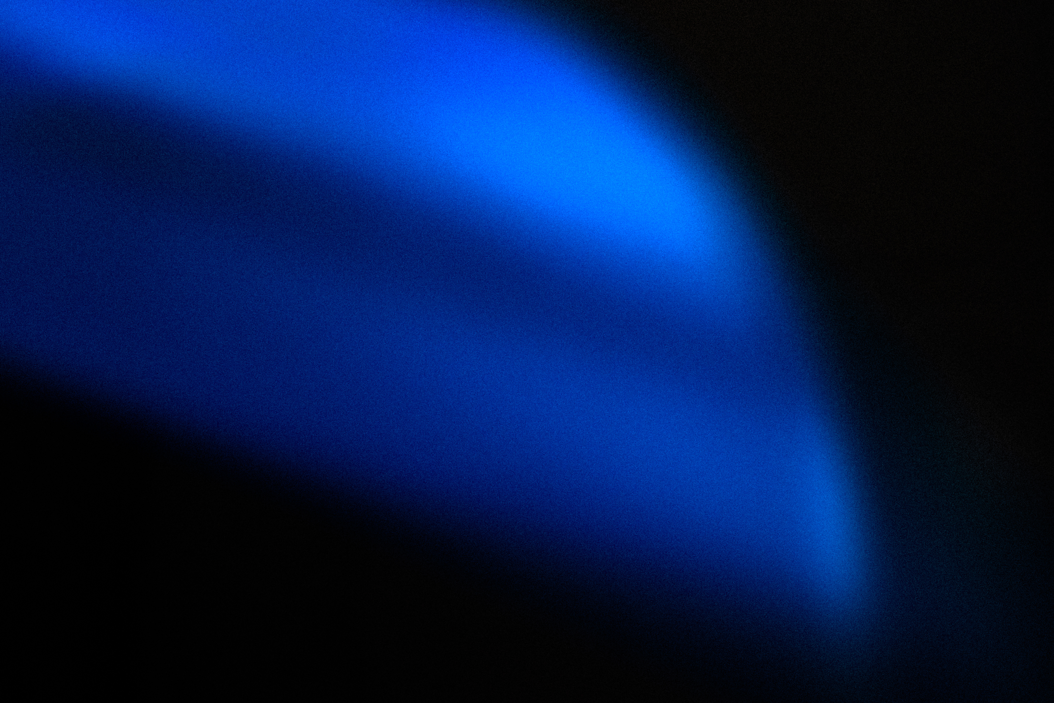
the design
The logo for Team SARANZA is made to have a simple but eye catching design.
Black and white is the chosen colors for the logo to make it look good in everything it rests on.
gestalt’s law
team logo
Proximity, Similarity, Figure-Ground, Closure, Symmetry and Continuity

Slide 4
the design
The logo for SYNCO is made to have a simple but eye catching design, similar to our teams logo.
The 5 hands is because of the name SYNCO or where we got the name from which is “cinco” or 5.
Shades of blue are used because it is one of the colors associated with unity/teamwork.
gestalt’s law
Proximity, Similarity, Figure-Ground, Closure, Symmetry and Continuity
SYNCO’s icon

Slide 5
fun facts!
01
02
03
our team name is the combination of our last names! “SA” for Salinas and Sambas and “RANZA” for Lipranza
SYNCO means Student Y(i)nteraction Nurturing Connected Outputs
was almost named COLLABRA but we didn’t like how it sounded and looked

